Slide 1


DEVELOPMENT OF AN AUTONOMUS OFFBOARD NAVIGATION VEHICLE

Slide 2








CDRB

Slide 3

INTRODUCTION

Slide 4


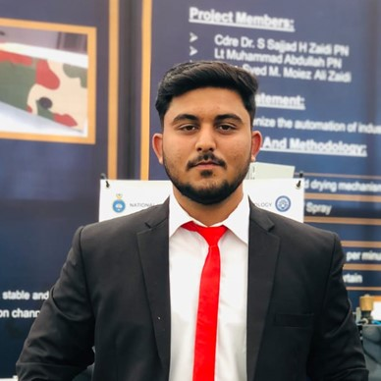



OUR TEAM
M.TAYYAB
M.MUBASHIR
KHANZADA
DR. BILAL
ADVISOR
SHEHARYAR FAISAL
M.ABDULLAH

Slide 5


ACKNOWLEDGMENT
WOOT TECH :​
Project Financial and Technical Sponsor​
Industry Advisor: Dr Bilal (Founder/CEO at Woot tech)
DR.BILAL

Slide 6
PROBLEM STATEMENT

Slide 7
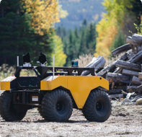
PROBLEM STATEMENT
Woot Tech, a leader in UAV systems for military and defense, aims to integrate UAVs with unmanned ground, and surface vehicles (UGVs/USVs). The goal is to create a unified, human-in-the-loop mission system that combines various autonomous vehicles.​

Slide 8

MILITARY APPLICATION

Slide 9
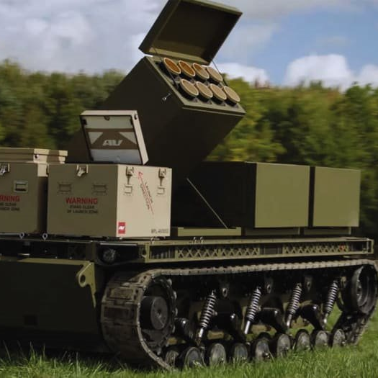
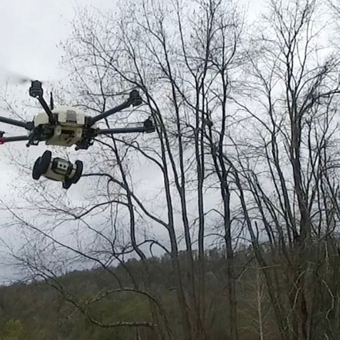
LAUNCHING AND LANDING DRONES AUTONOMOUSLY.​

Slide 10
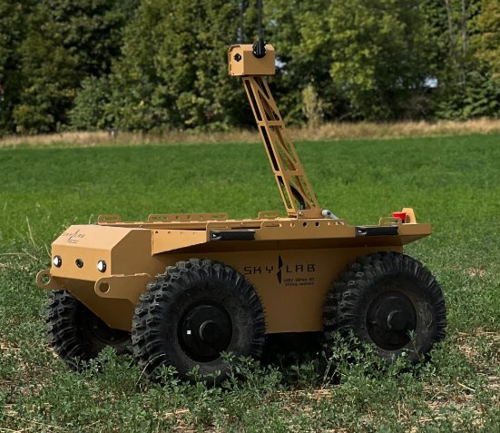
SURVEILLANCE AND RECONNAISSANCE

Slide 11
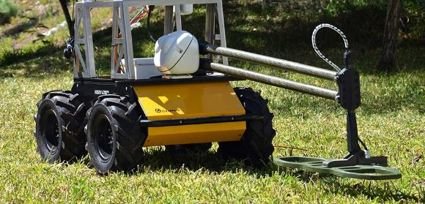
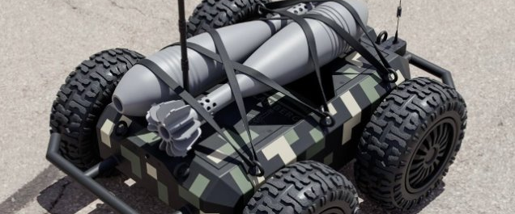
SUICIDE MISSIONS AND MINE DETECTION, REDUCING HUMAN RISK

Slide 12

INDUSTRIAL USES​

Slide 13
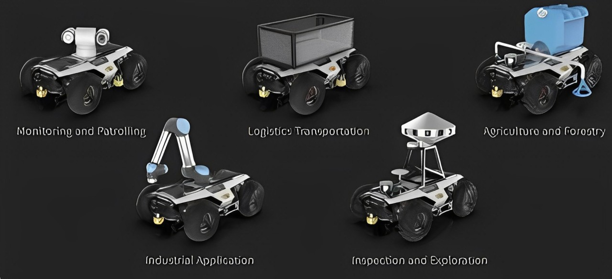

Monitoring and Patrolling
Logistics and Transportation
Agriculture and Forestry
Industrial Application
Inspection and Exploration
Electronics and Power Engineering Department- PNEC- NUST

Slide 14

LITERATURE
REVIEW

Slide 15
LITERATURE REVIEW
Sno.​ | PAPER NAME​ | DESCRIPTIONS​ | RESULTS/​ IMPLEMENTATION​
1​ | Towards Autonomous Driving with Small-Scale Cars: A Survey of Recent Development​ | Small-scale car are cost-effective | Same applied on full size vehicle
2​ | Automatic Steering Methods for Autonomous Automobile Path Tracking​ | Path tracking methods for car to reach its goal | Efficient trajectory following.
3​ | Reliable, Cloud-based Communication for Multi-Robot Systems​ | DDS for multi robot communication | It is implemented for multiple robot communication ​
4​ | WROOM: An Autonomous Driving Approach for Off-Road Navigation​ | RL model for dynamic path planning .​ | Tests the system on a real buggy RC car.​ ​
5​ | Multi-Sample Long Range Path Planning under Sensing Uncertainty for Off-Road Autonomous Driving​ | Introduces the DREAMS method for Dynamic path planning.​ | It is implemented on Sample A*, DRPS, and Direct method.

Slide 16

PROPOSED
SOLUTION

Slide 17
PROJECT IMPLEMENTATION FLOW DIAGRAM
Simulation In Gazebo With PX4 SITL and ROS2
FYP SCOPE
Implementation and Testing on Scaled Vehicle.
INDUSTRY SCOPE
Implementation and Testing on an ALL-Terrain Vehicle.

Slide 18
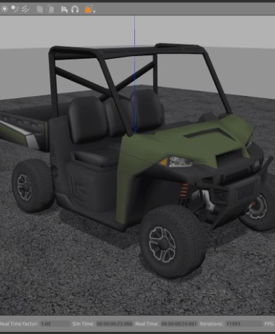
SIMULATION ON GAZEBO​
Offroad World in Gazebo: Simulating realistic off-road terrain and obstacles.​
PX4 SITL: Testing vehicle control and dynamics virtually before hardware.​
ROS2 Nodes: Executing real-time trajectory commands.​
Multiple Sensors: Testing LiDAR, GPS, IMU, and cameras for navigation and detection.

Slide 19
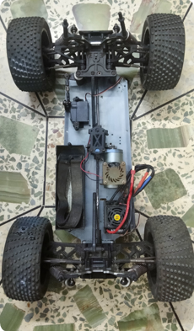
1/8th SCALE ELECTRIC ATV​
Mechanical Design: Body is being designed to incorporate electronics and sensors.​
Performance:​
Max Speed: 20 km/h.​
Endurance: 50 mins​
Payload Capacity: Supports up to 4 to 5 kg.​

Slide 20


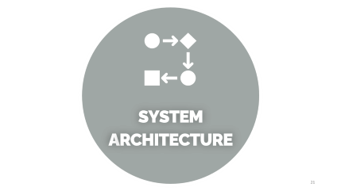

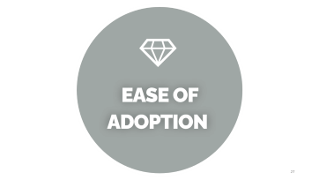

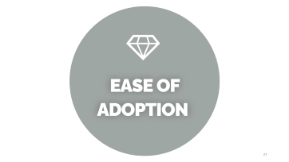
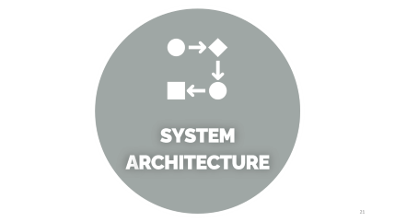
CDRB

Slide 21

SYSTEM
ARCHITECTURE

Slide 22
SYSTEM ARCHITECTURE
DEPTH CAMERA
EMBEDED COMPUTER
RUNNIING ROS2
HIGH LEVEL PATH PLANNER
PIXHAWK Low Level Controller
LIDAR
PAYLOAD
MOTORS / ACTUATORS
INPUT
OUTPUT
CONTROL
GPS /SPEED SENSOR

Slide 23
SYSTEM
SPECIFICATION

Slide 24
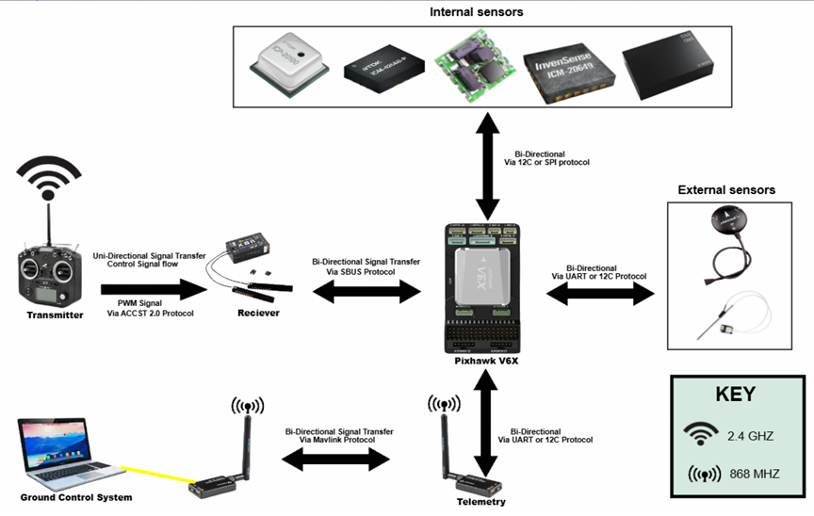

Slide 25

TESTING
CRITERIA

Slide 26
Testing Criteria
PHASE 1 : Simulation
Develop Simulation model of vehicle using GAZEBO
Test Model for different scenarios
PHASE 2 : Remote Control Testing
PHASE 3: Low Level Controller Implementation
Phase 4: Trajectory Waypoints Through ROS2
Addition of computer control of the vehicle and have it drive autonomously based on a set of stored GPS waypoints.
FYP SCOPE TILL HERE
Phase 4: Obstacle Avoidance
Phase 4 is to have the vehicle run autonomously and avoid obstacles using LIDAR and other sensors.
Phase 5: Feature Addition
Phase 5 is to have the vehicle autonomously traverse a specific bounded area and map its environment.

Slide 27

EASE OF
ADOPTION

Slide 28
EASE OF ADOPTION
Modular Architecture​
Robust Documentation​
Community Support
Simulation Capabilities​​
Scalability​
Real-Time Performance​
Open Source​

Slide 29
EXPECTED FINAL DELIVERABLES
Expected Final Deliverables
Simulation:
PX4 software-in-loop with Gazebo and ROS2.
Hardware Implementation:
1/8 scale truck with point-to-point navigation through GPS using ROS2.
Ground station control with live video feed.
Hardware Integration:
Interfacing LiDAR, cameras, and depth cameras to prepare for field testing.
Electronics and Power Engineering Department- PNEC- NUST

Slide 30
FUTURE DIRECTION
Currently designing a base framework on which future implementations/specifications can be added based on scenario​
Robotic hand or tools can be mounted and integrated for manufacturing purposes​
Spraying Mechanism with Object Detection Model can be added for Agriculture purpose​
Software system can be altered for surveillance situations​
Weapon system can be mounted for military use​

Slide 31








CDRB

Slide 32

ATTAINABLE
SDG’s

Slide 33




ATTAINABLE SDGs

Slide 34
BUSINESS
DIMENSION

Slide 35
BUSINESS DIMESNION & COMMERICALIZATION ASPECTS
Strong Industry Interest
Shift in Warfare Dynamics
Enhanced Border Security
Logistics and Warehouse Optimization
Integration with Robotic Components

Slide 36
TENTATIVE BUDGET
Item ​ | Description ​ | Quantity​ | Unit Cost (Rs)​ | Total Cost (Rs)​
Battery ​ | 4s 5000mah​ | 1​ | 10,000​ | 10,000​
Pixhawk 6c​ | Controller​ | 1​ | 200,000​ | 200,000​
Raspberry PI​ | Edge computer​ | 1​ | 50,000​ | 50,000​
1/8 scale RC car​ | Vehicle frame​ | 1​ | 40,000​ | 40,000​
WiFi Router​ | 5g​ | 1​ | 20,000​ | 20,000​
Gimbal Camera​ | RGB camera​ | 1​ | 50,000​ | 50,000​
Depth Camera​ | RGBD camera​ | 1​ | 200,000​ | 200,000​
Lidar​ | Out-Door 60m​ | 1​ | 800,000​ | 800,000​
GPS​ | HERE 3​ | 1​ | 100,000​ | 100,000​
Transmitter​ | ​ | 1​ | 50,000​ | 50,000​
Telemetry​ | ​ | 1​ | 20,000​ | 20,000​
Miscellaneous​ | Wiring, PCBs, etc​ | 1​ | 20,000​ | 20,000​
​ | ​ | ​ | TOTAL​ | 1,560,000​

Slide 37
GANTT
CHART

Slide 38
GANTT CHART
Planning R2 Begin
Planning R2 Begin
Planning R2 Begin
Feb 10
Aug 14
May 1
Aug 4
Jun 26
Oct 19
Aug 1
Oct 2
May 11 - Jun 30
Jun 30 - Aug 17
Aug 11 - Oct 21
Mar 1 - May 16
Aug 18 - Oct 4
Apr 1 - May 13
Jan 1 - Mar 6
Apr 1 - Oct 21
Oct 1 - Dec 22
Feb 1 - Mar 25
5/17 - 7/20
Mar 1 - Apr 1
Today
145.5 days
45 days
46.5 days
36.5 days
34.5 days
33.5 days
30.5 days
23.5 days
50.7 days
58.5 days
38.5 days
54.5 days
2022
2022
Phase II Developed
Phase III Developed
Mar
Apr
Planning Completed
Phase I Developed
Oct 10
Dec
DAB
AB
2024
2025
Jun
July
Aug
Sept
Oct
Nov
Dec
Jan
Feb
Mar
April
May
Phase I Planning
Plan
Meetings with Industry
Literature Review
CDRB Preparation
Simulation
Research & Planning
(Phase I)
Execution
Select Necessary
Hardware & Software
Implementation on RC car
System Development(Phase II)
Testing
Testing & Validation
DAB
Testing & Validation
(Phase III)
Documentation
38

Slide 39
WORK
DIVISION

Slide 40
WORK DIVISION
Sheharyar Faisal
Simulation
Software modification
Muhammad Tayyab
Rover Navigation
Simulation Model Setup
Muhammad Abdullah
Hardware and Software
Automation
Control
M. Mubashir Khanzada
Electrical Integration
Power distribution
Electronics and Power Engineering Department- PNEC- NUST

Slide 41
REFERENCES
Kalaria, Dvij et al. “WROOM: An Autonomous Driving Approach for Off-Road Navigation.” ArXiv abs/2404.08855 (2024): n. pag.​
Li, Dianzhao & Auerbach, Paul & Okhrin, Ostap. (2024). Towards Autonomous Driving with Small-Scale Cars: A Survey of Recent Development. ​
R. Hartanto and M. Eich, "Reliable, cloud-based communication for multi-robot systems," 2014 IEEE International Conference on Technologies for Practical Robot Applications (TePRA), Woburn, MA, USA, 2014, pp. 1-8, doi: 10.1109/TePRA.2014.6869142. keywords: {Robot sensing systems;Reliability;Couplings;Observers;OWL}.​
Snider, J.M. (2009). Automatic Steering Methods for Autonomous Automobile Path Tracking.​

Slide 42

THANK YOU
42

